Slide 1
IBM University Engagement Project Submission
“Exploring the Power of Agentic AI”

Slide 2

Project Title – AI Agent for Digital Financial Literacy
Domain of Project – Financial Technology
Student Name | Recent Passport Photo | Email ID | Mobile number [WhatsApp]
P . KAVYA SAI |  | 2420030322cse@gmail.com | 9911436234
AICTE ID- STU69fb650b2f6091778083083

Slide 3
Problem Statement -
Problem Statement #7 – AI Agent for Digital Financial Literacy
The Challenge
Millions of people in India still struggle with financial literacy despite the rapid growth of digital financial services. Understanding topics such as UPI transactions, online scam prevention, loan interest rates, budgeting, income tax filing, and personal finance management can be confusing, especially for first-time users and non-English speakers.
Current financial resources are often:
Complex and difficult to understand
Primarily available in English
Scattered across multiple websites
Dependent on expensive professional assistance
As a result, first-generation earners, rural communities, senior citizens, and digitally inexperienced users remain vulnerable to financial fraud and poor financial decisions.

Slide 4
Proposed Solution -
TaxSmart AI is a full-stack RAG-based AI agent for Indian Digital Financial Literacy built entirely on IBM Cloud Lite services. It provides:
A conversational AI chat interface where users ask tax and finance questions in English or Hindi and receive cited, grounded answers
A Tax Calculator that instantly compares Old vs New regime and recommends the better option
A Filing Readiness Meter that scores the user's ITR preparation out of 100 and generates a personalized action plan
A Smart Form Vault where users download official tax forms with IBM Granite-generated fill guides, upload completed documents to IBM Cloud Object Storage, and receive instant AI-powered document scans
An AI Document Completeness Checker that audits 12 key tax documents and tells users exactly what is missing and where to obtain it
A Deadline Calendar showing all ITR and advance tax deadlines on an interactive calendar
Voice input in both English and Hindi for accessibility

Slide 5
Technology Used
Layer | Technology
Frontend | React 18
Backend | Python 3.13, Flask
LLM | mistralai/mistral-small via IBM watsonx.ai
NLP | IBM Watson Natural Language Understanding
RAG | ChromaDB + sentence-transformers (all-MiniLM-L6-v2)
PDF Processing | PyMuPDF (fitz)
Document Storage | IBM Cloud Object Storage
Voice | Browser Web Speech API
IBM Services | watsonx.ai, Watson ML, Watson NLU, Watson Assistant, IBM COS, IBM watsonx Code Assistant (Bob)

Slide 6
IBM Services and Development Tools — Working & Role
1. watsonx.ai (Foundation Models)
How it works:
Connected via IBM watsonx.ai Python SDK (ibm-watsonx-ai)
Uses mistralai/mistral-small-3-1-24b-instruct-2503 model
Called via .chat() method with system + user messages
Role in project:
Generates all AI responses in chat
Creates step-by-step form fill guides
Analyzes uploaded PDF documents and extracts tax info
Generates Filing Readiness score + action plan
Performs Document Completeness audit
Responds in Hindi or English based on language toggle
2. Watson Machine Learning
How it works:
WML instance is associated with the watsonx.ai project
Provides the inference endpoint (us-south.ml.cloud.ibm.com)
All foundation model API calls route through WML
Role in project:
Serves as the compute layer that hosts and runs the foundation model
Authenticates API requests using IAM
Without WML, watsonx.ai cannot serve model responses

Slide 7
IBM Services and Development Tools — Working & Role
3. Watson Natural Language Understanding (NLU)
How it works:
Connected via ibm-watson Python SDK
Called on every user question before RAG search
Uses KeywordsOptions(limit=5) to extract top 5 keywords
Role in project:
Extracts semantic keywords from user questions
Keywords are appended to the search query to improve RAG retrieval accuracy
Example: "Can I save tax on home loan?" → NLU extracts ["home loan", "tax", "deduction"] → Better ChromaDB search results
Extracted keywords are shown in the chat UI as "NLU detected"
4. Watson Assistant
How it works:
Created as a Lite instance on IBM Cloud
Configured as a Web channel assistant
Active as a registered IBM service in the project
Role in project:
Registered conversational AI service
Represents the enterprise chatbot layer of the architecture
Listed as active IBM service in the UI sidebar
Future integration: embed as chat widget on deployed version

Slide 8
IBM Services and Development Tools — Working & Role
5. IBM Cloud Object Storage (COS)
How it works:
Connected via ibm-cos-sdk (S3-compatible API)
Uses IAM authentication with API key + instance ID
Bucket: taxsmart-documents in us-south region
Role in project:
Stores all uploaded tax documents securely in the cloud
/upload endpoint → PyMuPDF extracts text → file uploaded to COS with metadata
/documents endpoint → lists all files from COS bucket
/documents/<key> DELETE → removes file from COS
When user uploads Form16.pdf → stored permanently on IBM Cloud, not locally
Enables Document Vault to persist across sessions
6. IBM watsonx Code Assistant (Bob)
How it works:
Used during development as the AI coding assistant
Provides intelligent code completions, suggestions and debugging help
Role in project:
Used to write and debug Flask API endpoints
Assisted in building React components
Helped optimize the RAG pipeline code
Suggested fixes for IBM SDK integration errors
Made development faster and more efficient

Slide 9
IBM tools Overview
# | Service | Role
1 | watsonx.ai | LLM inference
2 | Watson Machine Learning | Model serving
3 | Watson NLU | Keyword extraction
4 | Watson Assistant | Conversational AI
5 | Cloud Object Storage | Document storage
6 | IBM watsonx Code Assistant (Bob) | Development tool

Slide 10
Langflow component Used -
Since TaxSmart AI uses a custom RAG pipeline rather than Langflow directly, the equivalent Langflow components that map to our architecture are:
Chat Input → User question enters the pipeline
Watson NLU Node → Extracts keywords from the question
ChromaDB Retriever → Searches 15-document knowledge base using semantic similarity
Prompt Template → Combines user question + retrieved docs + language instruction + keywords
watsonx.ai LLM Node → Mistral model generates the final response
IBM COS Tool → Handles document upload, retrieval and deletion
PyMuPDF Parser → Extracts text from uploaded PDF documents
Chat Output → Returns answer with citations to the user

Slide 11
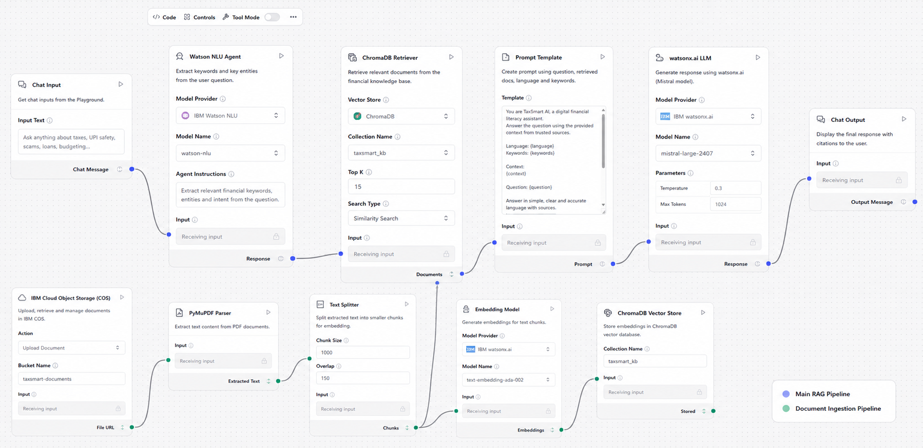
Langflow workflow -

Slide 12
Langflow workflow -
Workflow Description
The Langflow architecture demonstrates the complete Retrieval-Augmented Generation (RAG) pipeline used in TaxSmart AI for delivering accurate and trustworthy financial guidance.
Chat Input – User submits a financial query (e.g., tax filing, UPI safety, budgeting).
Watson NLU Agent – Extracts keywords, entities, and user intent to improve search accuracy.
ChromaDB Retriever – Performs semantic search on the financial knowledge base to retrieve the most relevant document chunks.
Prompt Template – Combines the user query, retrieved context, extracted keywords, and language preference into a structured prompt.
watsonx.ai LLM (Mistral) – Generates accurate, multilingual, and context-aware responses using retrieved information.
Chat Output – Returns the final response with reliable, source-backed financial guidance.
Document Ingestion Pipeline
Documents uploaded to IBM Cloud Object Storage (COS) are parsed using PyMuPDF, split into smaller chunks, converted into vector embeddings, and stored in ChromaDB. These embeddings are later retrieved during user queries, ensuring responses are grounded in trusted financial resources.

Slide 13
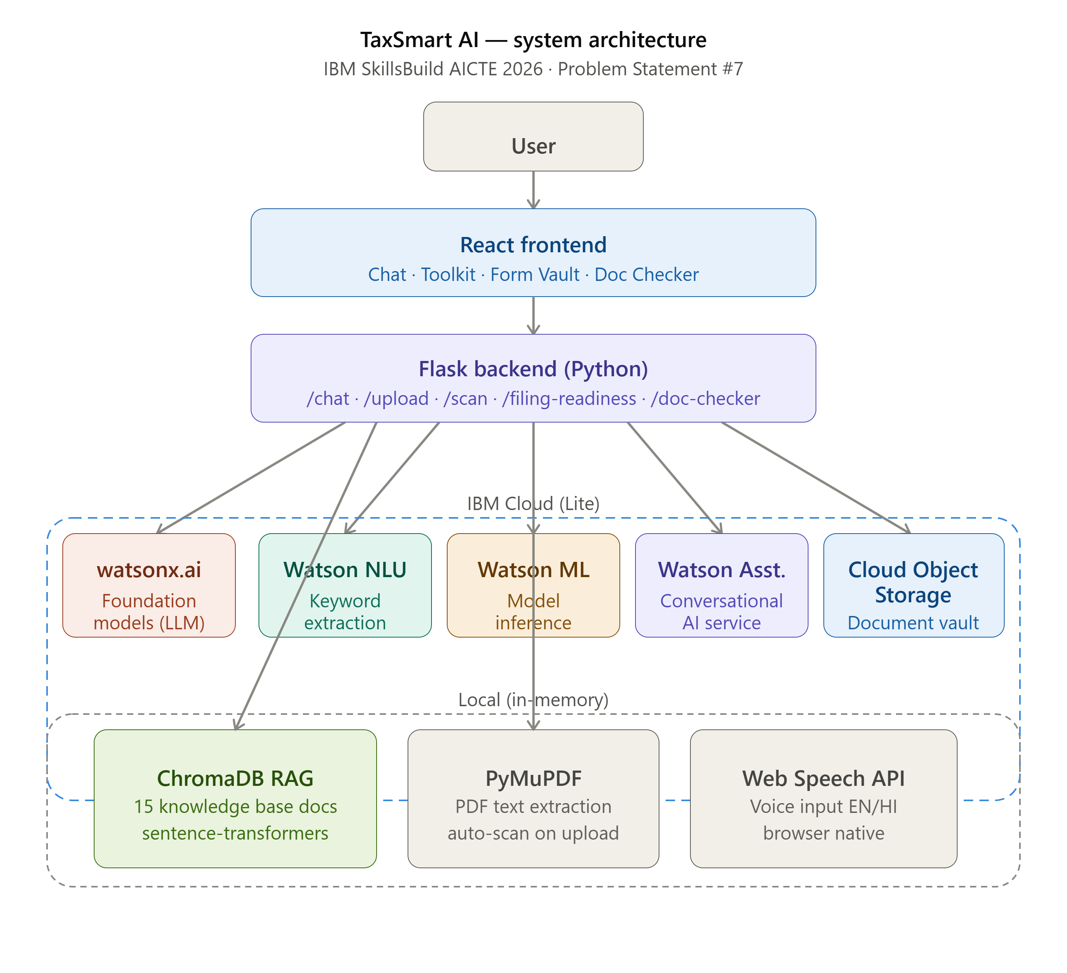
Architecture Blueprint

Slide 14

Role of Agentic AI in the solution
TaxSmart AI demonstrates multiple dimensions of Agentic AI:
Autonomous Decision Making — The agent decides which knowledge base documents are most relevant for each query without human intervention, using semantic search and NLU keyword boosting.
Multi-step Reasoning — For the Filing Readiness Meter, the agent takes user inputs across 3 steps, reasons about missing documents, calculates a readiness score, identifies the correct ITR form, and generates a personalized action plan — all autonomously.
Tool Use — The agent uses multiple tools: Watson NLU for intent extraction, ChromaDB for retrieval, IBM COS for file operations, and PyMuPDF for document parsing — choosing the right tool for each task.
Multilingual Adaptation — The agent dynamically adjusts its response language based on user preference without retraining.
Document Intelligence — When a tax document is uploaded, the agent autonomously extracts text, identifies document type, extracts key amounts and dates, checks completeness, and cross-links findings to the Doc Checker — all in one step.
Citation-Based Transparency — The agent shows exactly which knowledge base source it used for each answer, demonstrating explainable AI behavior.

Slide 15
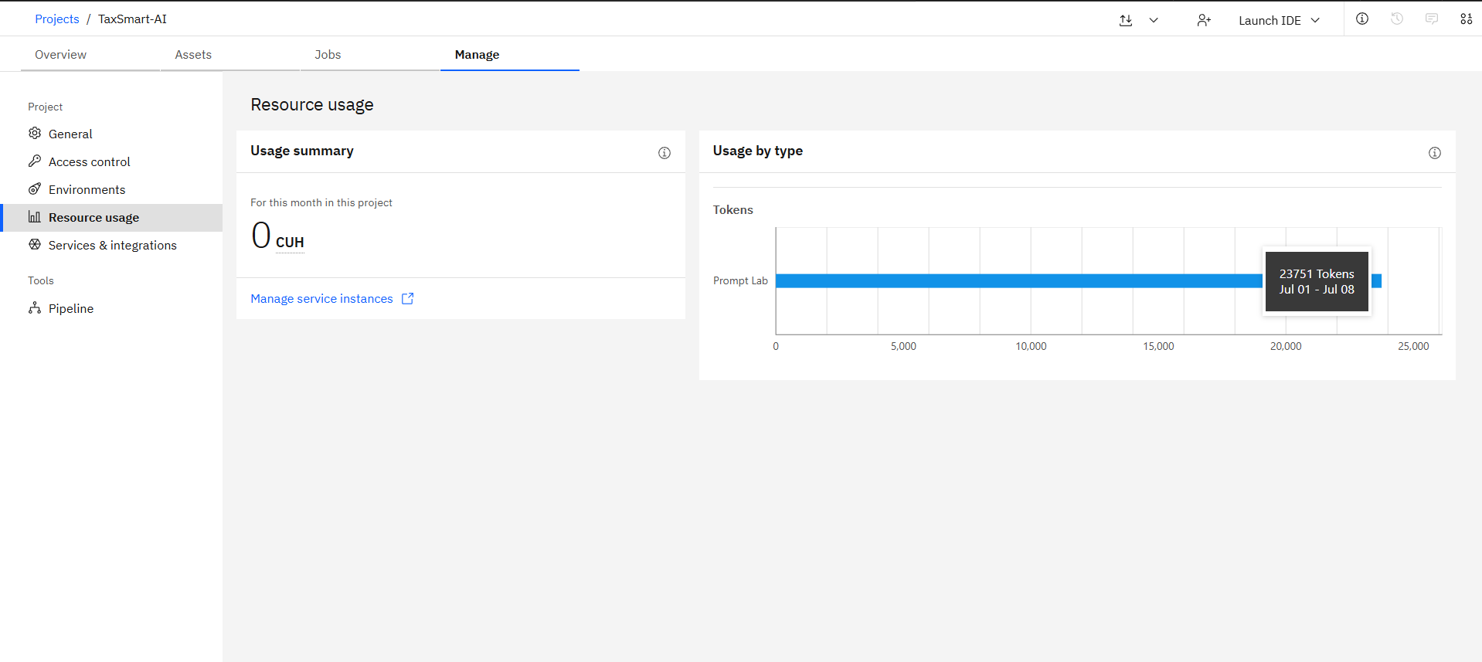
Token Usage
23,751 token are used
·
·
·

Slide 16
Novelty and Uniqueness
TaxSmart AI stands out from existing tools in several ways:
Citation-Based RAG — Unlike generic chatbots, every answer shows exactly which knowledge base document it came from, making the AI explainable and trustworthy.
Cross-Feature Intelligence — Uploading a PDF in Form Vault automatically ticks the corresponding checkbox in Doc Checker. No other tax tool has this cross-feature document awareness.
Unified Platform — Combines 7 distinct features (chat, calculator, calendar, readiness meter, form vault, document scanner, completeness checker) in one IBM Cloud-powered platform — most tools offer only 1-2 of these.
Genuinely Bilingual — Not just translated UI — the IBM Granite LLM responds in Hindi when selected, including in document scans and form guides.
5 IBM Cloud Services Actively Integrated — All 5 services are actively used in the data flow, not just listed. Each service has a specific role in the RAG pipeline or document management workflow.
Free Tier Deployment — Entire project runs on IBM Cloud Lite (free) services, making it reproducible and accessible for other students and developers.
Built with IBM Tools End-to-End — Development itself used IBM watsonx Code Assistant (Bob)for AI-assisted coding, making this a fully IBM-native project from development environment to deployment infrastructure.

Slide 17
Git Hub Link
·
https://github.com/Kavya20060702/TaxSmart-AI.git
Google Drive Link
https://drive.google.com/drive/folders/1QMsRfcVp-iTPfoIQtXuxTb5shqu7Ao06?usp=sharing
Deployment Link
https://tax-smart-ai.vercel.app/
Demo Video
https://drive.google.com/file/d/1JDCiTXEtTSa-cRoQ9hyDUSrvHWSWH33e/view?usp=sharing

Slide 18
TaxSmart AI — Feature List
CORE AI
Citation-Based RAG Chat
Watson NLU Keyword Detection
Hindi / English Bilingual Responses
Voice Input (EN + HI)
TOOLKIT
Tax Calculator (Old vs New Regime)
Deadline Calendar (Interactive)
Filing Readiness Meter (Score /100)
DOCUMENT INTELLIGENCE
Smart Form Vault
Tax Form Library (6 Forms)
IBM Granite AI Form Fill Guide
Document Upload to IBM COS
AI Auto-Scan on Upload
Manual Document Scanner
AI Document Completeness Checker
Auto-Link Upload → Doc Checker
ACCESSIBILITY
Voice Input (Browser Speech API)
Hindi Language Toggle
Suggested Questions
·
·
·

Slide 19
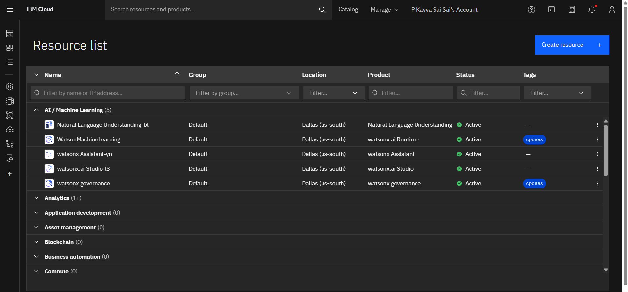
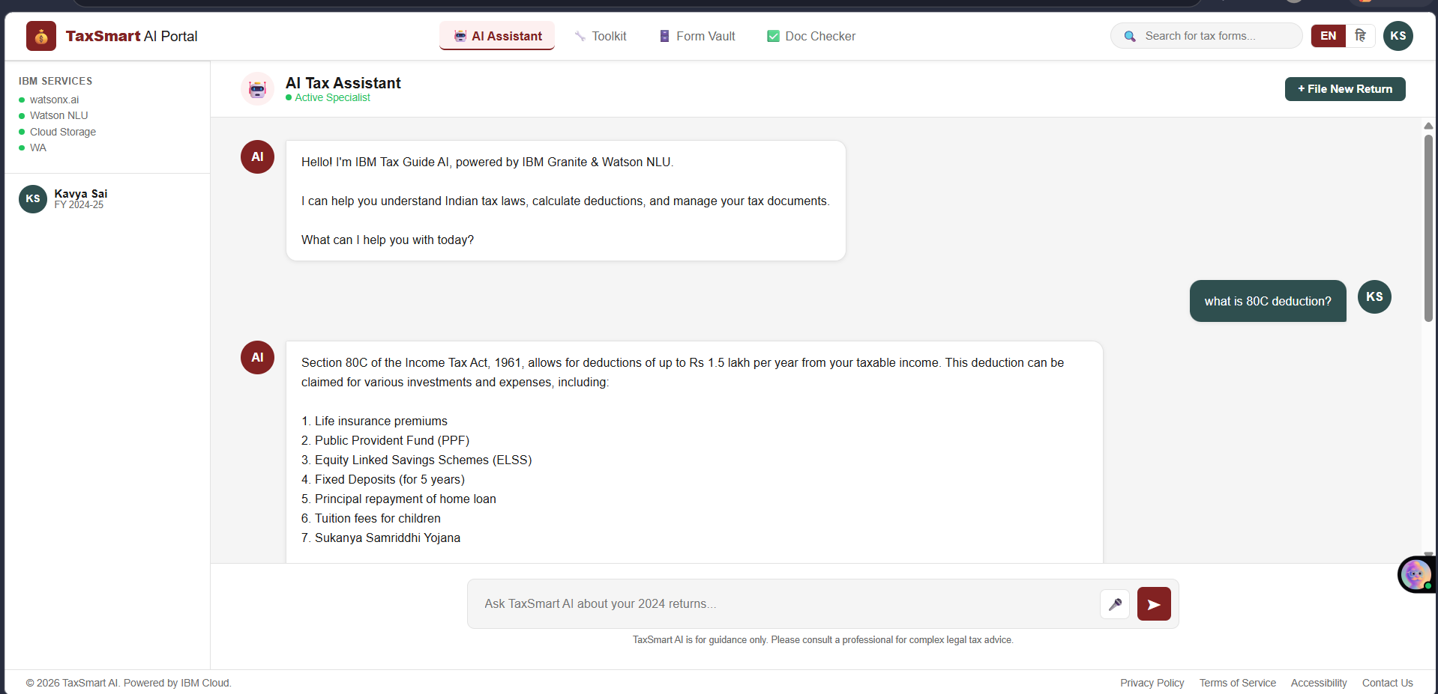
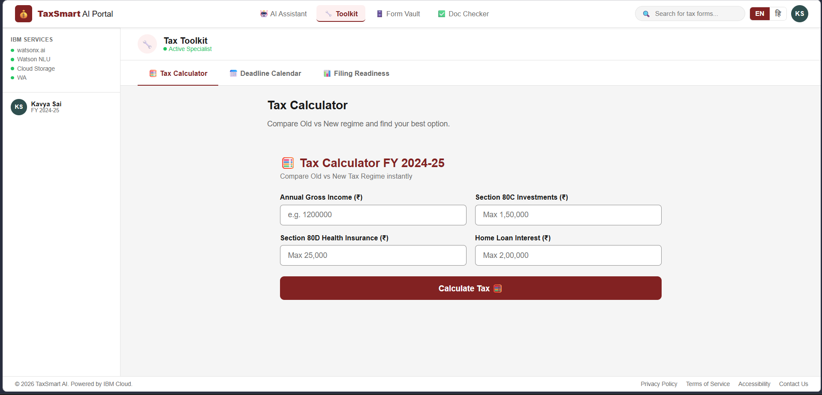
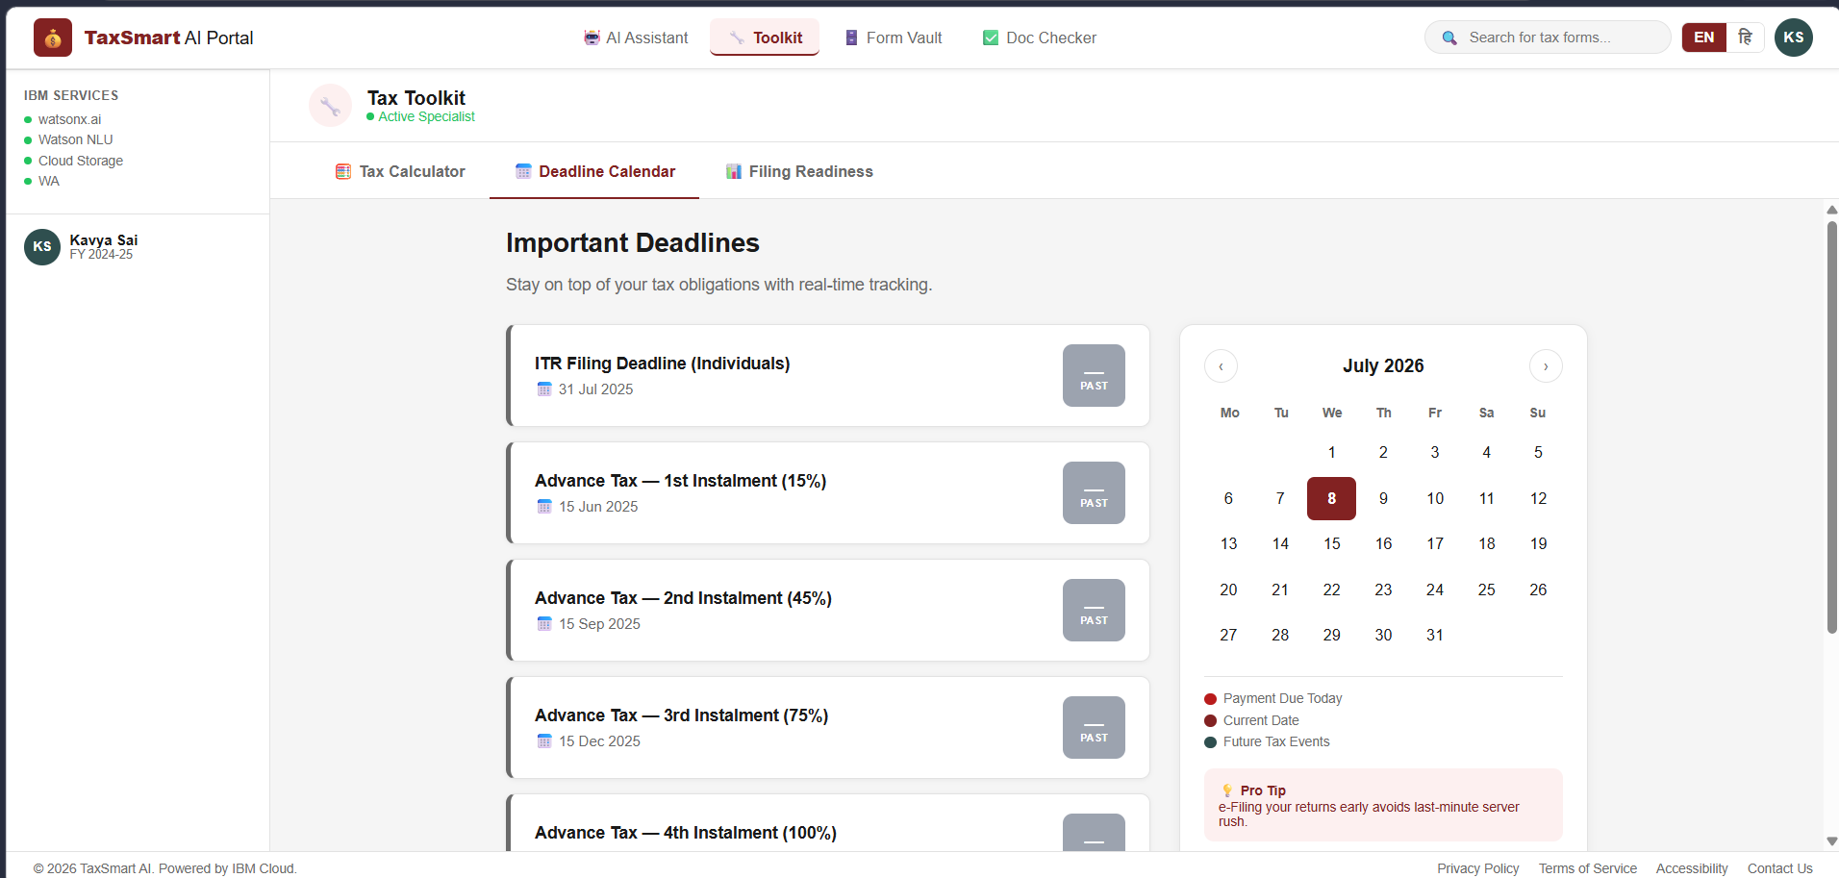
ScreenShots
·
·
·

Slide 20
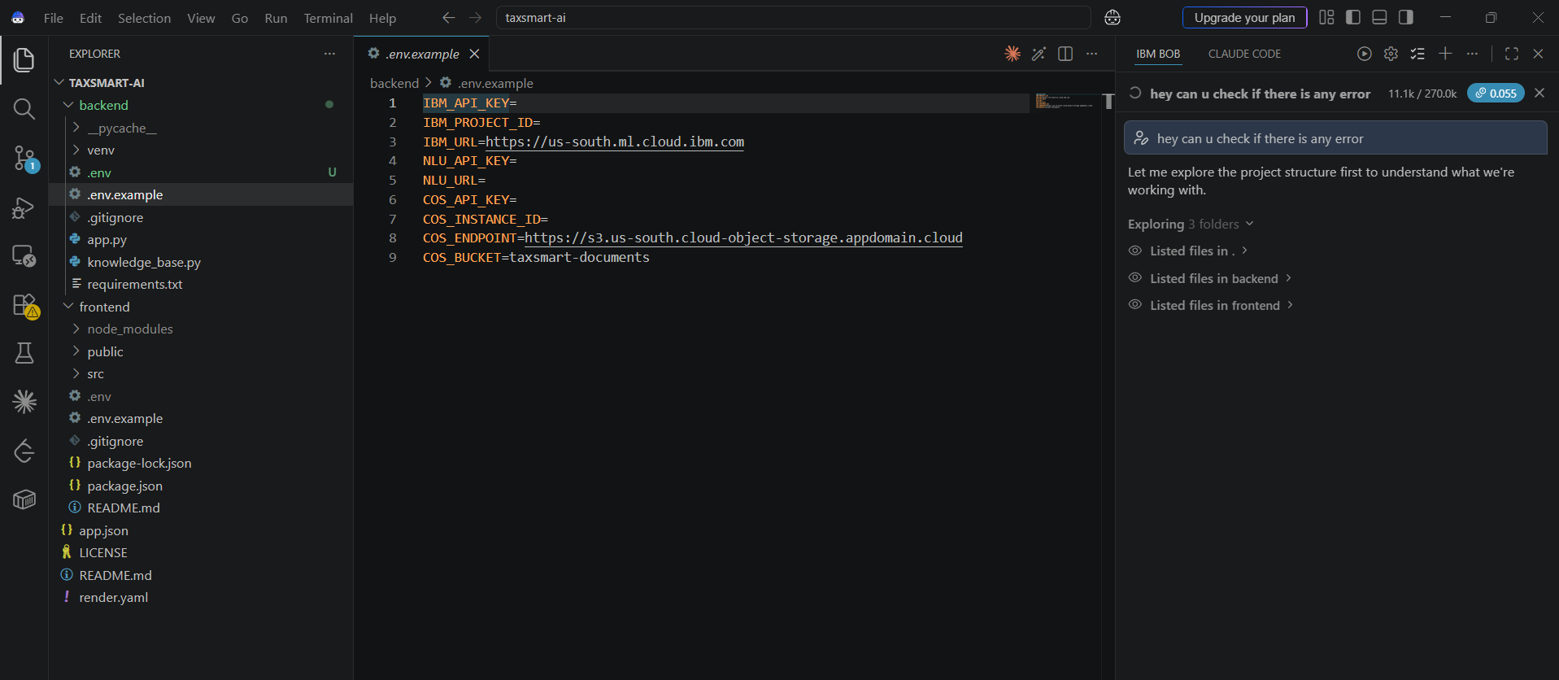
ScreenShots
·
·
·

Slide 21
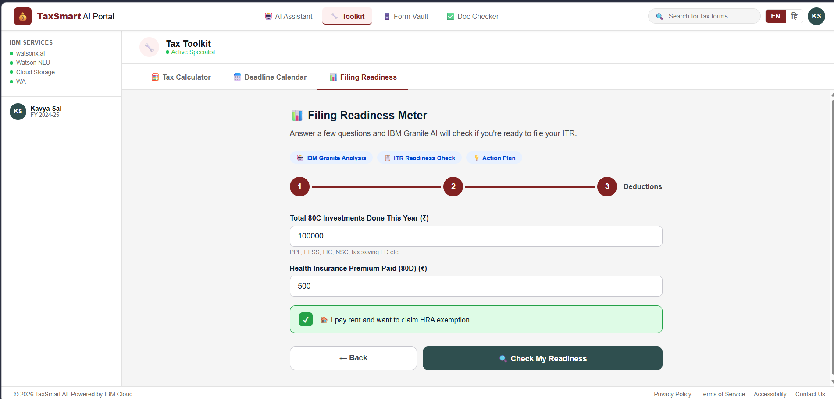
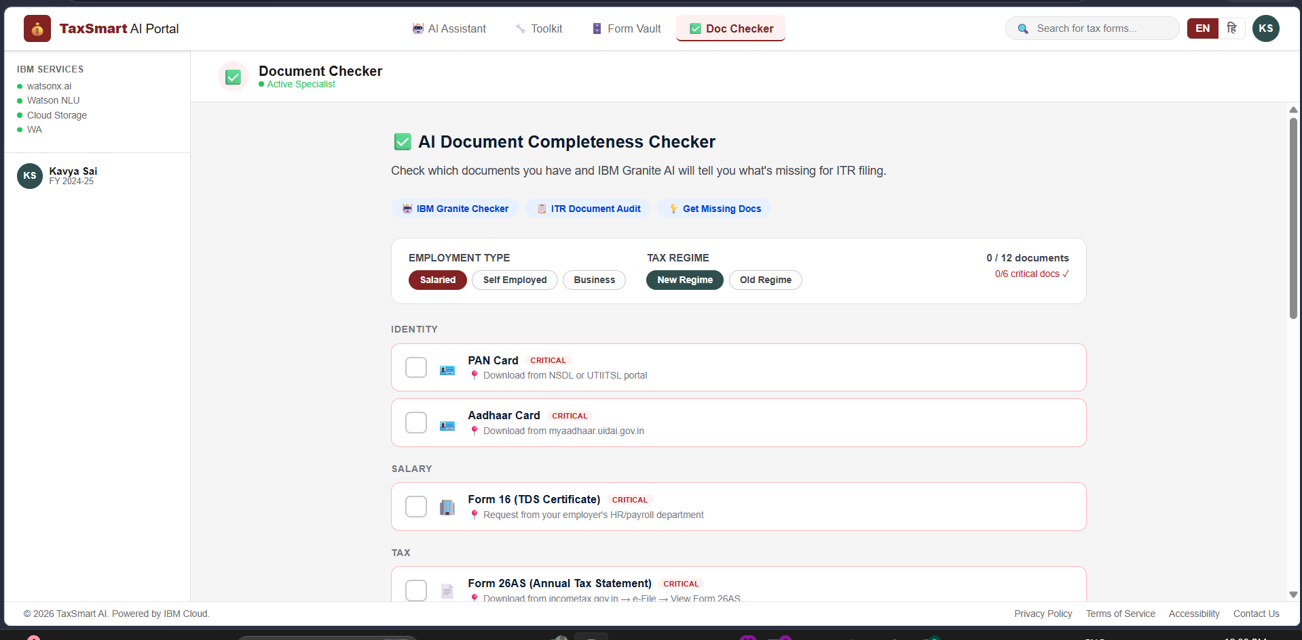
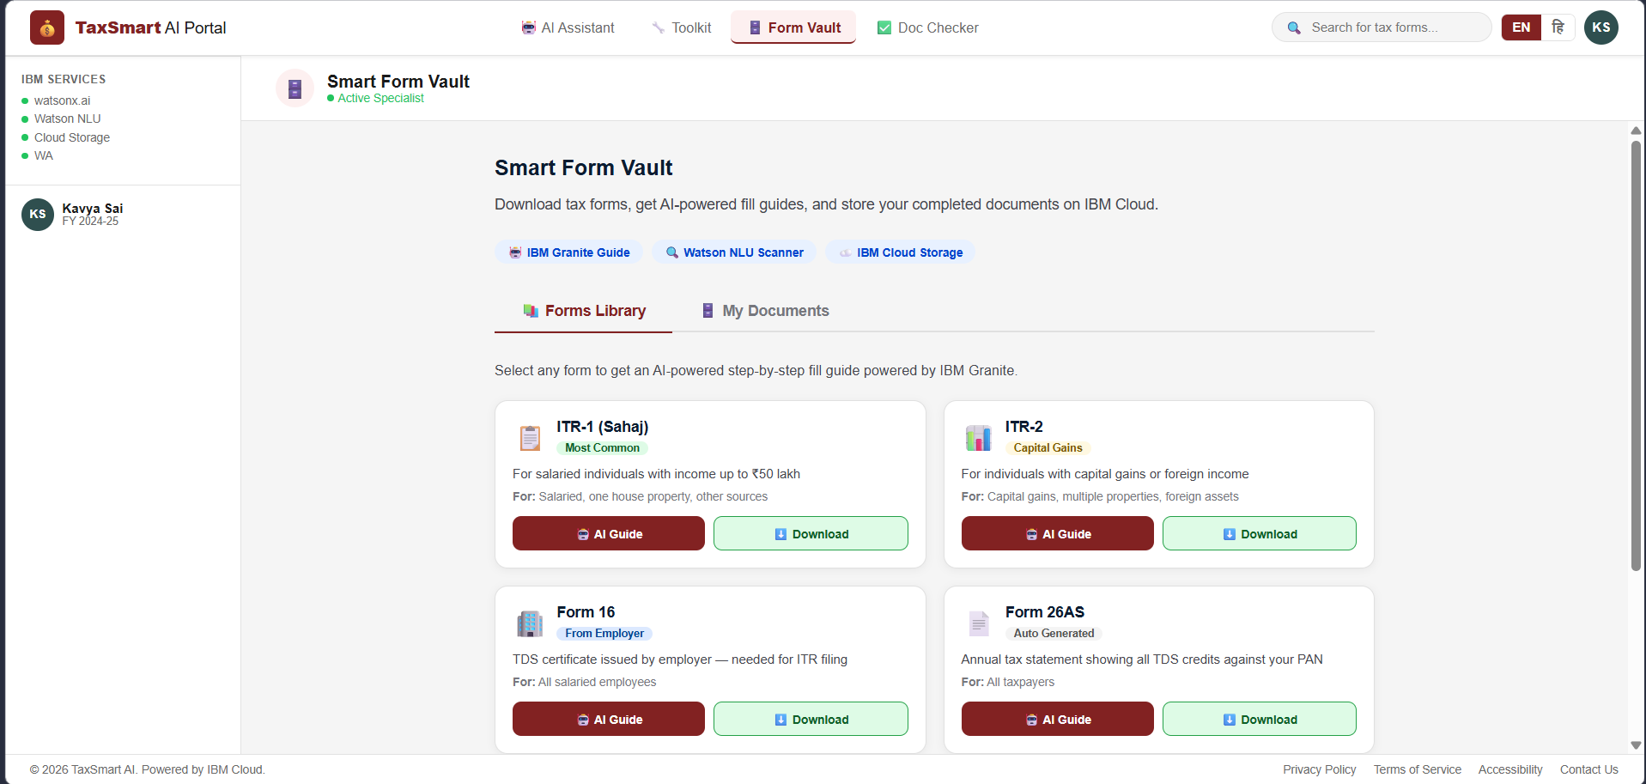
ScreenShots
·
·
·

Slide 22
Future Scope
Real-time Income Tax Portal Integration — Connect directly to incometax.gov.in APIs to fetch live Form 26AS, AIS/TIS data and pre-fill the Doc Checker automatically.
Automated ITR Pre-filling — Use uploaded Form 16 and 26AS to auto-populate ITR fields and generate a draft return for review.
WhatsApp / SMS Bot — Deploy TaxSmart AI on WhatsApp using Watson Assistant for rural citizens without smartphone apps.
Regional Language Expansion — Extend beyond Hindi to Tamil, Telugu, Marathi, Bengali using IBM's multilingual models — covering 95% of India's population.
Tax Professional Marketplace — Connect users who need expert help with certified CAs directly from the platform.
Watson Discovery Integration — Replace ChromaDB with Watson Discovery for enterprise-grade RAG with automatic document ingestion from government portals.
Predictive Tax Planning — Use historical income data to predict next year's tax liability and suggest optimal investment timing throughout the year.
Mobile App — React Native version with offline knowledge base for users with limited internet connectivity.
·
·
·

Slide 23
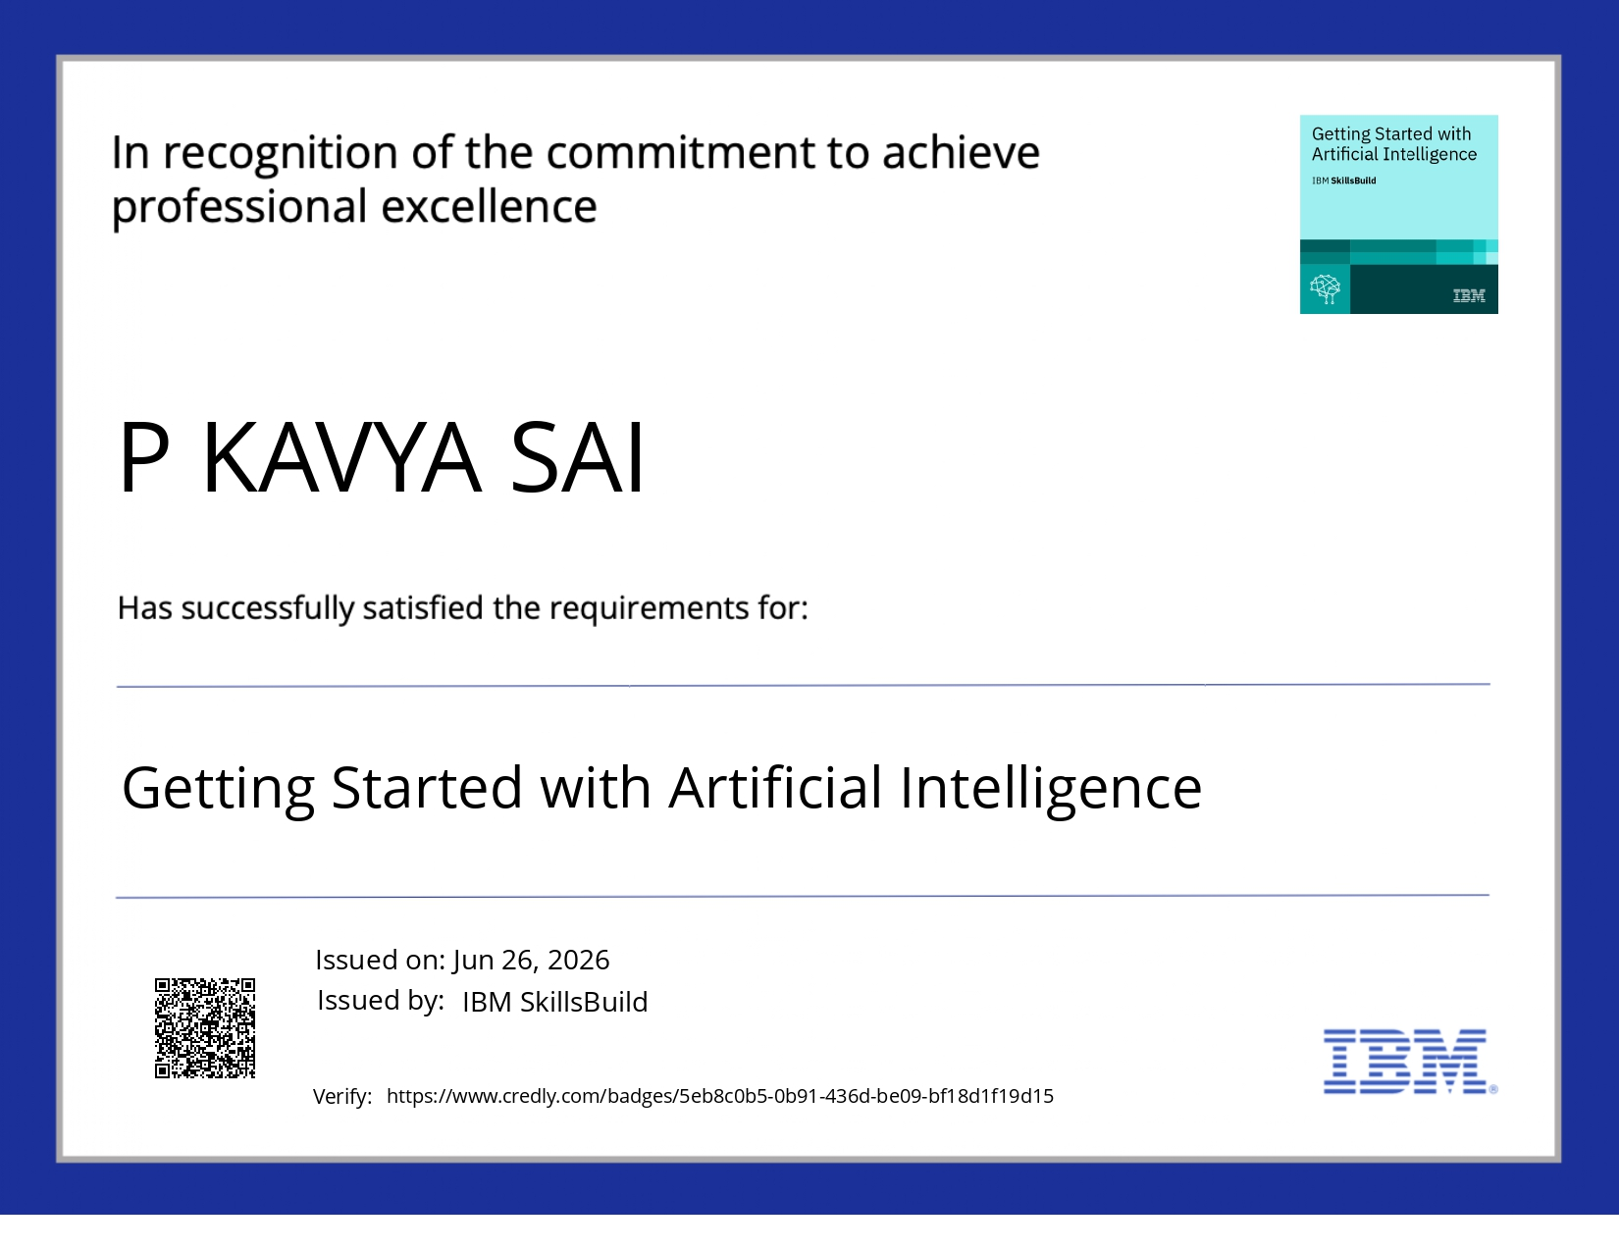
Certificates Earned:
Getting Started With Artificial Intelligence

Slide 24
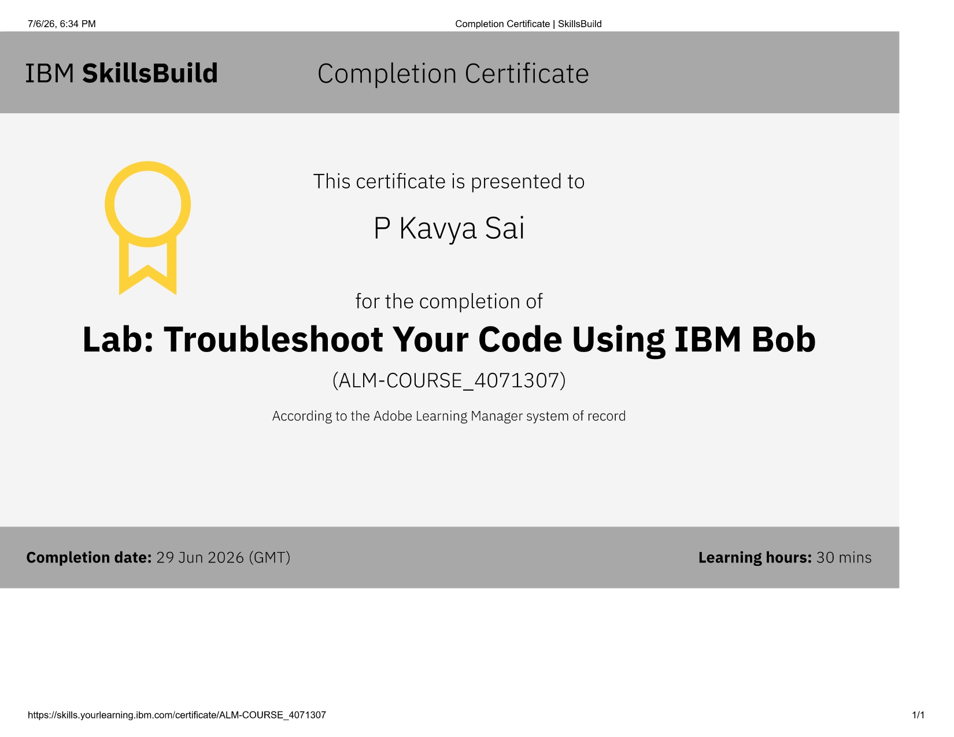
Certificates Earned:​
IBM BOB Certificate

Slide 25
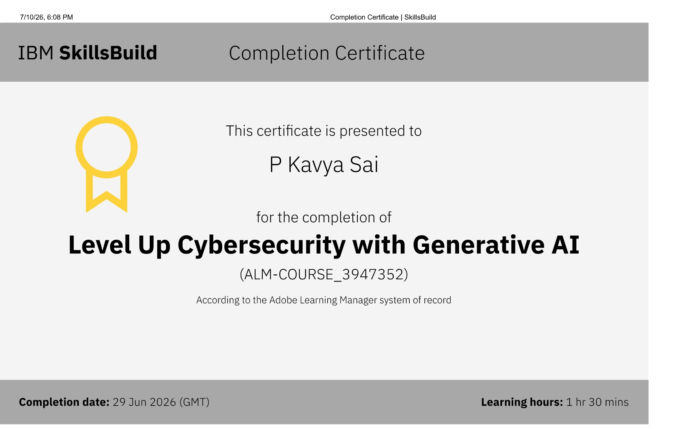
Certificates Earned:
Level Up Cybersecurity with Generative AI

Slide 26
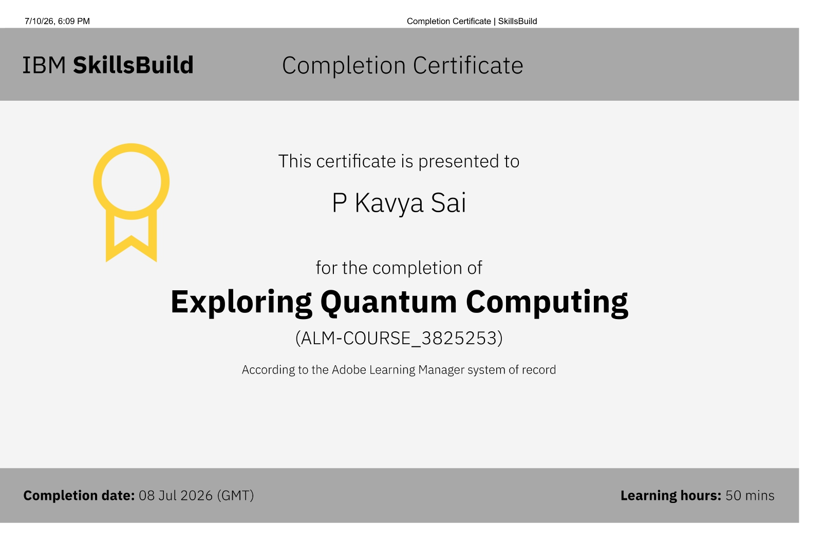
Certificates Earned:
Exploring Quantum Computing

Slide 27
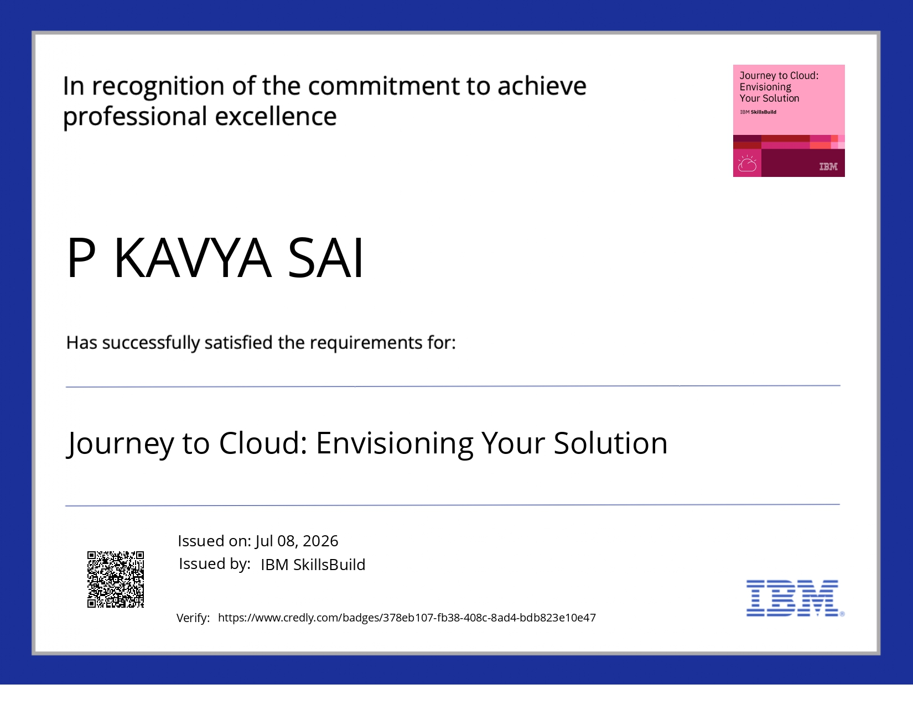
Certificates Earned:
Journey to Cloud: Envisioning Your Solution

Slide 28

Certificates Earned:
Getting Started with Cybersecurity

Slide 29
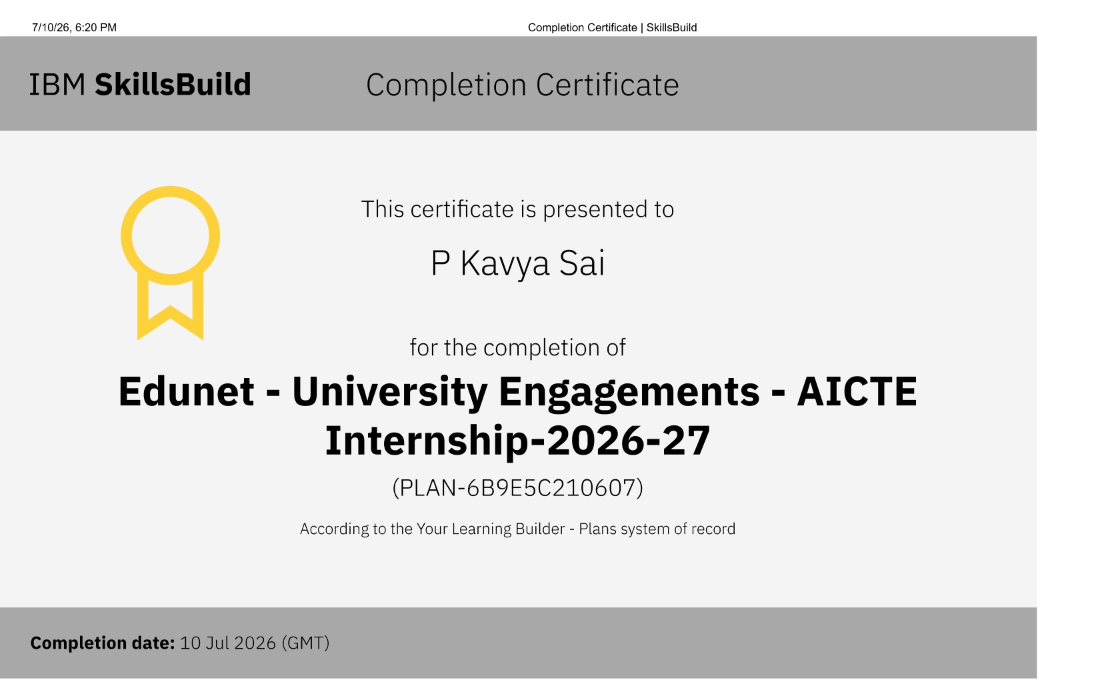
Certificates Earned:
Edunet-University Engagements-AICTE-Internship-2026-2027

Slide 30


